Slide 1

Twitter Overspending A/B testing
Lokesh Sharma

Slide 2
AGENDA
01
02
Problem Statement
Project Overview
05
Conclusion
03
04
Recommendations
Key Insights

Slide 3
Problem Statement
How can Twitter reduce ad campaign overspending, considering that delayed click reporting causes advertisers to exceed their budgets? Has the new ad product, which charges per impression rather than per click, successfully minimized overspending compared to the existing click-based model, as demonstrated by recent A/B test results?

Slide 4
Project Overview
Challenge: Advertisers on Twitter, operating under click-based billing model, often overspend due to a delay between ad clicks and billing.
Proposed Solution: Implement an impression-based billing mode to minimize billing latency.
Experiment: An A/B test was conducted:
Control Group: Maintained the existing click-based billing.
Treatment Group: Utilized the new impression-based billing.
Full Name
Title
Write a brief bio for this team member. Mention their background, area of expertise, and their role in this research project.

Slide 5
Descriptive Statistics
Budget Performance Overview:
Average Overspend: Campaigns averaged 21.46% over budget.
Typical Campaigns: Most campaigns experienced a slight overspend (median of ~5.62%).
High Variability: There was a significant spread in spending performance across campaigns.
Extreme Overspend: Some campaigns overspent by as much as 400%.
Underspend: Conversely, some campaigns underspent their budget by up to 57.49%.

Slide 6
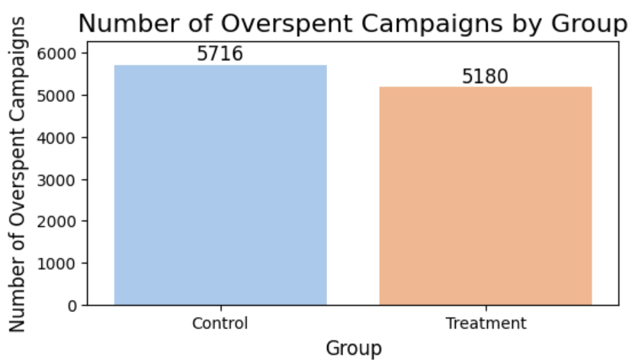

Overspending Trends:
Control vs. Treatment Groups
Control Group: 5,716 campaigns (overspending >1% of budget)
Treatment Group: 5,180 campaigns (overspending >1% of budget)
Insight: The treatment group demonstrates a lower incidence of overspending compared to the control group.
Campaign Overspending Count

Slide 7
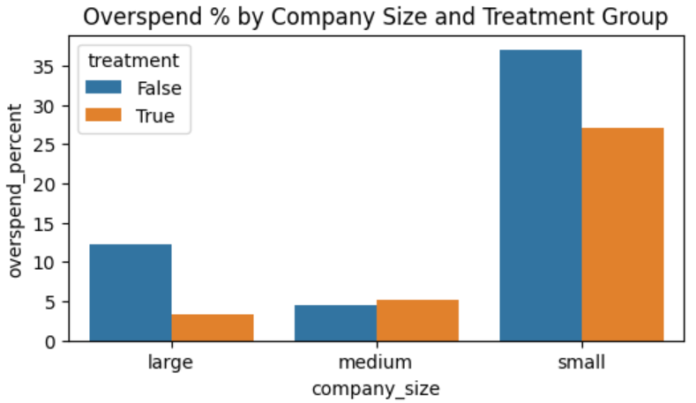

Company Size and Overspend Reduction
The new model significantly benefits both large and small companies, with minimal impact on medium-sized businesses. A statistically significant difference in overspend percentages was observed between the control and treatment groups.

Slide 8
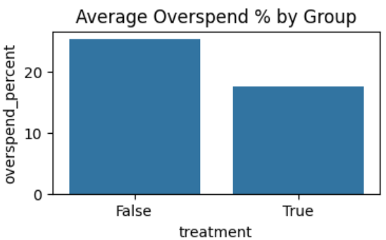
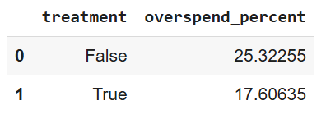
Comparing Overspend Percentages
The impression-based model (treatment group) significantly reduced average overspending compared to the control group, demonstrating its effectiveness. Overspending decreased by approximately 7.71 percentage points, confirming the new billing model's success.

Slide 9
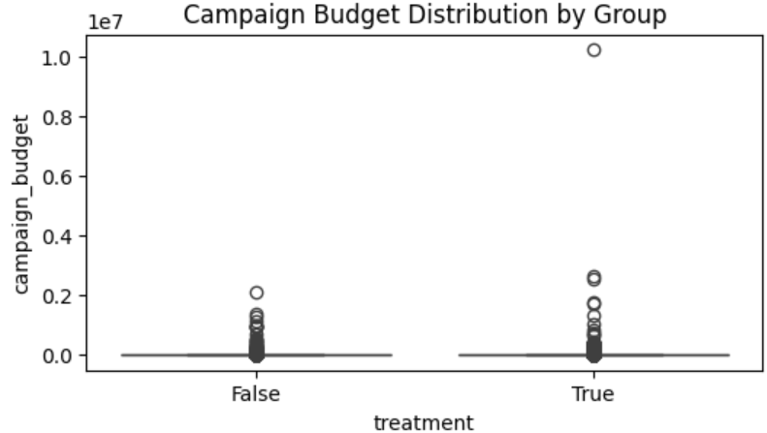
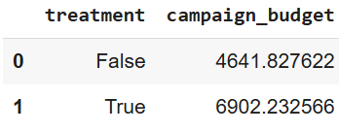

Budget Entry Behavior
Average Budgets:
Control: 4,641.83
Treatment: 6,902.23
Conclusion: No significant difference observed in budgets; therefore, no evidence suggests advertisers are lowering their budgets.

Slide 10
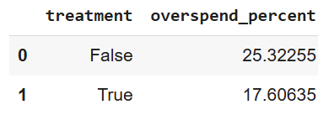

Average Overspend Percentages
Control Group: 25.32%
Treatment Group: 17.60%
A statistically significant reduction in overspending was observed.

Slide 11
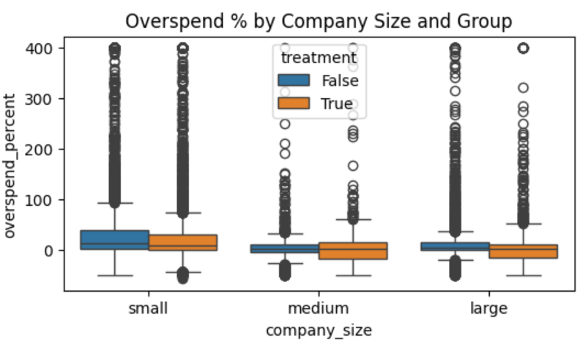
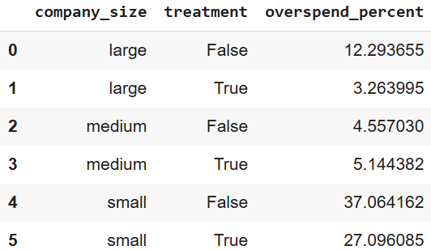
Company Overspend Trends: A Group and Size Analysis
The new billing model disproportionately benefits large companies.
Small companies, despite consistently overspending, experience reduced overspend with the new treatment.
Medium companies exhibit negligible differences between control and treatment groups.

Slide 12
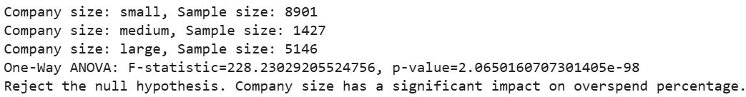
Company Size: A Demographic Factor
One-Way ANOVA Results:
F-statistic: 228.23
P-value: 2.07e-98
Conclusion: Company size significantly impacts overspending, with small companies consistently overspending the most.

Slide 13

Variance Comparison
Control Group Variance: 5,456.99
Treatment Group Variance: 4,876.91
F-statistic: 1.12
Conclusion: The variances are not significantly different, indicating similar spending variability between the groups.

Slide 14
Examining the Link Between Treatment and Overspending
Key Findings on Billing Model and Overspending:
Chi-Square Statistic: 90.67
P-Value: 1.70e-21
A statistically significant association exists between the billing model (treatment/control) and overspending.
Overspending is dependent on the billing model employed.
The impression-based billing model (treatment group) demonstrates a lower likelihood of overspending.

Slide 15
Recommendation
Strategic Rollout of Impression-Based Model
Broad Deployment: Implement the Impression-Based Model across all relevant platforms and campaigns.
Targeted Marketing: Emphasize budget control advantages in all marketing and promotional materials.
Enhanced Advertiser Tools: Develop and offer new budget management tools specifically for small advertisers.
Performance Monitoring: Continuously track key metrics such as Click-Through Rate (CTR), user engagement, and overall advertiser satisfaction following the rollout.
Tailored Support & Education: Customize support and educational resources based on the size of the company to ensure maximum effectiveness.

Slide 16
Conclusion
Our new billing model significantly reduces overspending for companies of all sizes, particularly large and small enterprises. We've observed no indication of advertisers setting lower budgets in the treatment group, and spending variability remains consistent. A key finding is that company size significantly influences overspending patterns.

Slide 17
Thank you!

